Slide 1









Setting a Marked
Price for a Property

Slide 2
Background Information

Slide 3
Background Information
Have you ever wondered why two houses that seem similar can have very different prices?
Welcome to the activity of real estate pricing! We will explore how to set a marked price for a property using mathematical modelling.
Real estate pricing is not only based on location but also influenced by many factors, such as the floor area and age of the building.

Slide 4
Background Information
Imagine you are a real estate agent trying to determine the best price for a property. You have lots of data – the marked prices of various properties along with their corresponding floor areas and ages of buildings. Your task is to use this data to build models that can predict the price of a property.
By analysing how different factors impacts the price, you can create mathematical models. This activity will equip you with the skills to make informed and strategic pricing decisions. Get ready to become a savvy real estate expert!

Slide 5
Setting a marked price for a property
Worksheet 1

Slide 6
Activity 1A
To recall prerequisite knowledge

Slide 7
To recall prerequisite knowledge
1. Before we dive into the complexities of real estate pricing,
let’s start with a simpler problem.
We first print some booklets for promotion.
(a) The cost $y of printing x booklets is calculated by the following formula:
Find the cost of printing 50 booklets.

Slide 8
To recall prerequisite knowledge
Solution:
(a) Put into the equation.
∴ The cost of printing 50 booklets is $350.

Slide 9
To recall prerequisite knowledge
(b) For a linear equation in two unknowns, we can plot its graph.
Consider the equation in (a),
Complete the following table and draw its graph.
x | 10 | 20 | 30
y

Slide 10
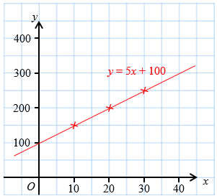
To recall prerequisite knowledge
Solution:
(b) Consider the equation in (a),
Complete the following table and draw its graph.
x | 10 | 20 | 30
y | 150 | 200 | 250

Slide 11
Activity 1B
To plot graphs and formulate models using MS Excel

Slide 12
To plot graphs and formulate models using MS Excel
2. In Question 1(a), we can use to calculate
the cost $y of printing x booklets.
In Question 1(b), we have plotted the graph of the equation.
The graph is a straight line.
can be regarded as a model that describes the relationship between
the number of booklets to print and the cost required.

Slide 13
To plot graphs and formulate models using MS Excel
3. In some situations,
however, we do not have the model at the very beginning.
For example, the time required (y) in minutes for
Machine A to print x booklets is recorded in the following table.
We can plot the graph and formulate the model using MS Excel.
Number of booklets (x) | 10 | 20 | 30 | 40
Time required (y) | 20 | 35 | 50 | 65

Slide 14
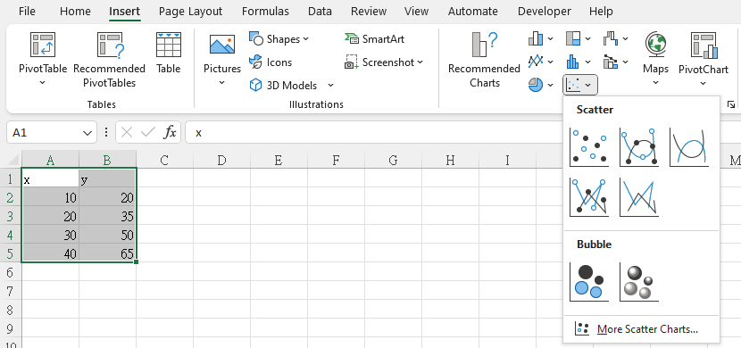
Steps

Slide 15
Steps
i. Input the data to MS Excel as in the following figure.
ii. Plot the graph.
Select the heading
and the data
Click Insert → Scatter

Slide 16
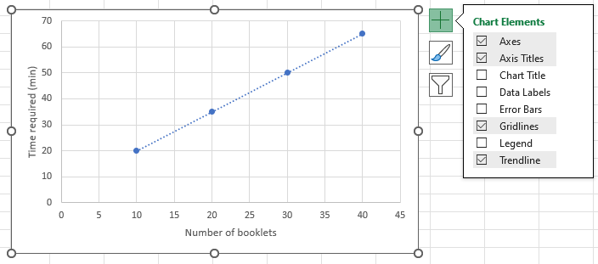
Steps
iii. Select Chart Elements as in the following figure.
Axes
Axis Title: Name the title of x-axis as “Number of booklets”
Axis Title: Name the title of y-axis as “Time required (min)”
Gridlines
Trendline

Slide 17
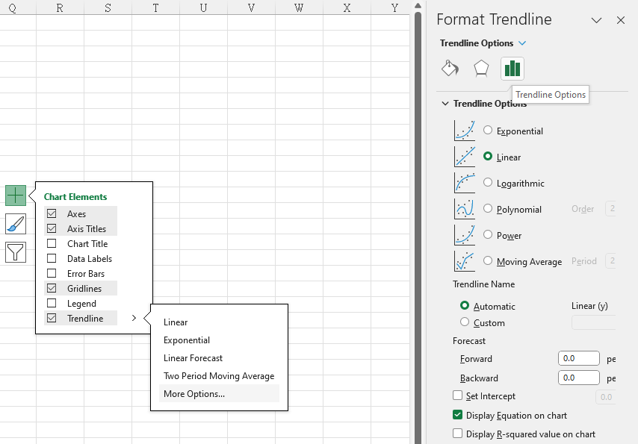
Steps
iv. Display the equation on the graph.
Click Trendline → More Options → Trendline Options
Select Linear and
Display Equation on chart

Slide 18
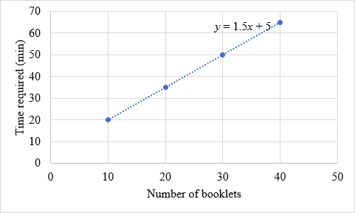
Steps
v. Refine the design of the graph. For example:
Adjust the size of the graph
Modify the font and font size

Slide 19
To plot graphs and formulate models using MS Excel
4. is a model that describes the relationship between
the number of booklets to print and the time required.
5. Using the model in Question 4,
estimate the time required to print 80 booklets.
Put into
∴ The time required to print 80 booklets is estimated at 125 minutes.

Slide 20
To plot graphs and formulate models using MS Excel
6. In the real world, it is not always possible to find a straight line that passes through all data points. However, we are able to observe a general trend. For example,
the booklets we print, the the time is required.
In this case, we have to find a line of best fit. That is a line that minimises the distance between the line and data points. Finding this line involves some advanced mathematics and statistics knowledge. Still, MS Excel can formulate the line of best fit based on our input data.
more
more

Slide 21
To plot graphs and formulate models using MS Excel
7. The following table shows the time required (y) in minutes for Machine B to print x booklets.
Number of booklets (x) | 10 | 20 | 30 | 40
Time required (y) | 21 | 34 | 49 | 67

Slide 22
To plot graphs and formulate models using MS Excel
7. The following table shows the time required (y) in minutes for Machine B to print x booklets.
Using MS Excel, plot a graph and formulate a model that describes the relationship between the number of booklets to print and the time required.
Number of booklets (x) | 10 | 20 | 30 | 40
Time required (y) | 21 | 34 | 49 | 67

Slide 23
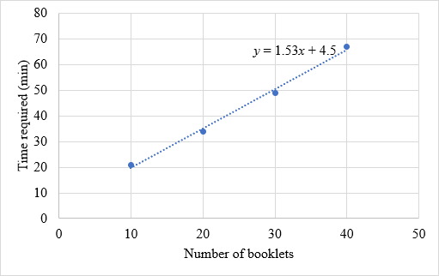
To plot graphs and formulate models using MS Excel
8. Solution:
∴ The model is

Slide 24
To plot graphs and formulate models using MS Excel
8. Using the model in Question 7,
estimate the time required to print 80 booklets.
Put into
∴ The time required to print 80 booklets is estimated at 127 minutes.

Slide 25
Assumptions and Limitations

Slide 26
Assumptions and Limitations
9. What are the assumptions and limitations of the model in Question 7?
Assumptions:
Linear relationship
No other factors
Limitations:
Oversimplification
Dependence on a small amount of data
1
2
1
2

Slide 27
Setting a marked price for a property
Worksheet 2

Slide 28
Activity 2
To use data of marked prices of properties alongside their corresponding floor areas to formulate a model

Slide 29
To use data of marked prices of properties alongside their corresponding floor areas to formulate a model
1. If we own a property in Hong Kong, what information do we need when setting a marked price for the property?
Size and layout: Floor area, number of rooms, bathrooms, and kitchens.
Condition: New, renovated, or need for refurbishment.
Property type: Private housing estate, public housing estate, or village house.
Facilities: Swimming pool, gym room, and parking.
Location: Proximity to transportation, schools, shopping centres.

Slide 30
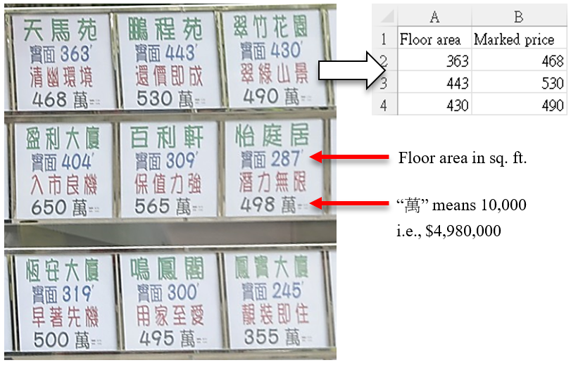
To use data of marked prices of properties alongside their corresponding floor areas to formulate a model
2. The following figure shows some real data of the marked prices of some properties and their corresponding floor areas.
(Source: https://www.scmp.com/business/article/3186280/loss-making-deals-hong-kongs-secondary-home-market-jump-sellers-take-hit)

Slide 31
To use data of marked prices of properties alongside their corresponding floor areas to formulate a model
2. Generally speaking, what is the relationship between the floor areas and the marked prices of properties?
The larger the floor area, the the marked price of the property.
higher
(Source: https://www.scmp.com/business/article/3186280/loss-making-deals-hong-kongs-secondary-home-market-jump-sellers-take-hit)

Slide 32
To use data of marked prices of properties alongside their corresponding floor areas to formulate a model
3. Input the data to MS Excel. For simplicity, you may use the input format as shown on the right-hand side of the following figure.
(Source: https://www.scmp.com/business/article/3186280/loss-making-deals-hong-kongs-secondary-home-market-jump-sellers-take-hit)

Slide 33
To use data of marked prices of properties alongside their corresponding floor areas to formulate a model
4. Plot a graph and formulate a model (Model A) that describes the relationship between the floor areas (x) and the marked prices of properties (y).

Slide 34
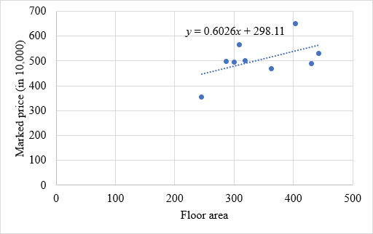
To use data of marked prices of properties alongside their corresponding floor areas to formulate a model
4. Solution:
∴ The model is

Slide 35
To use data of marked prices of properties alongside their corresponding floor areas to formulate a model
5. Given that the floor area of a property is 420 sq. ft.
Using Model A in Question 4, suggest a marked price for the property correct to 3 significant figures.
Model A:

Slide 36
To use data of marked prices of properties alongside their corresponding floor areas to formulate a model
5. Solution:
Put into
∴ The marked price for the property can be $5,510,000.

Slide 37

To use data of marked prices of properties alongside their corresponding floor areas to formulate a model
6. The following figure shows the marked price of the property in reality.
Are the actual marked price and the modelling outcome in Question 5 different? What are some possible reasons?

Slide 38
To use data of marked prices of properties alongside their corresponding floor areas to formulate a model
6. Solution:
Absolute error
Percentage error

Slide 39
To use data of marked prices of properties alongside their corresponding floor areas to formulate a model
6. Our suggested marked price is about 5% lower than the actual marked price. The owner may think that other factors, such as the scenic view and recent renovation of the property, have enhanced its value.

Slide 40
Assumptions and Limitations

Slide 41
Assumptions and Limitations
7. What are the assumptions and limitations of Model A in Question 4?
Assumptions:
Linear relationship
No other factors
Limitations:
Oversimplification
Dependence on a small amount of data
1
2
1
2

Slide 42
Setting a marked price for a property
Worksheet 3

Slide 43
Activity 3
To use data of marked prices of properties alongside their corresponding ages of buildings to formulate a model

Slide 44
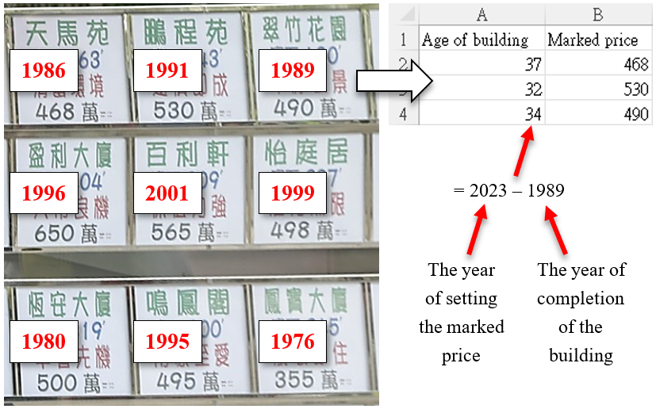
To use data of marked prices of properties alongside their corresponding ages of buildings to formulate a model
1. Let’s consider the ages of buildings. The following figure shows the year of completion of each building.
(Source: https://www.scmp.com/business/article/3186280/loss-making-deals-hong-kongs-secondary-home-market-jump-sellers-take-hit)

Slide 45
To use data of marked prices of properties alongside their corresponding ages of buildings to formulate a model
1. Generally speaking, what is the relationship between the ages of buildings and the marked prices of properties?
The greater the age of the building, the the marked price of the property.
lower
(Source: https://www.scmp.com/business/article/3186280/loss-making-deals-hong-kongs-secondary-home-market-jump-sellers-take-hit)

Slide 46
To use data of marked prices of properties alongside their corresponding ages of buildings to formulate a model
2. Input the data to MS Excel.
To calculate the ages of buildings, you may use the formula as shown on the right-hand side of the above figure.
(Source: https://www.scmp.com/business/article/3186280/loss-making-deals-hong-kongs-secondary-home-market-jump-sellers-take-hit)

Slide 47
To use data of marked prices of properties alongside their corresponding ages of buildings to formulate a model
3. Plot a graph and formulate a model (Model B) that describes the relationship between the ages of buildings (x) and the marked prices of properties (y).

Slide 48
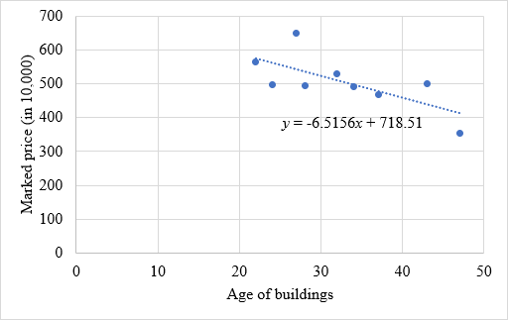
To use data of marked prices of properties alongside their corresponding ages of buildings to formulate a model
Solution:
∴The model is

Slide 49
To use data of marked prices of properties alongside their corresponding ages of buildings to formulate a model
4. For the property shown in the following figure, the year of completion of its building is 1985.
Using Model B in Question 3, suggest a marked price for the property correct to 3 significant figures.
Model B:

Slide 50
To use data of marked prices of properties alongside their corresponding ages of buildings to formulate a model
4. Solution:
The age of the building
Put into
∴ The marked price for the property can be $4,710,000

Slide 51
To use data of marked prices of properties alongside their corresponding ages of buildings to formulate a model
5. Comparing the suggested marked prices of Model A (Question 5 in Activity 2) and Model B (the above question), which one is closer to the actual marked price of the property? How can we interpret this observation?

Slide 52
To use data of marked prices of properties alongside their corresponding ages of buildings to formulate a model
5. Solution:
For Model A, there is a difference of $290,000.
But for Model B, there is a difference of $1,090,000.
In this case, the suggested marked price of Model A is closer to the actual marked price than that of Model B.
Compared with the floor area, the age of a building may be less influential on the marked price of a property.

Slide 53
Assumptions and Limitations

Slide 54
Assumptions and Limitations
6. What are the assumptions and limitations of Model B in Question 3?
Assumptions:
Linear relationship
No other factors
Limitations:
Oversimplification
Dependence on a small amount of data
1
2
1
2

Slide 55
Conclusion

Slide 56
Conclusion
In Activities 2 and 3, we used MS Excel to formulate the lines of best fit based on some real data.
These lines are useful to express the relationship of different data points.
However, both Activities 2 and 3 only consider one factor (the floor area; the age of a building) when formulating the model.

Slide 57
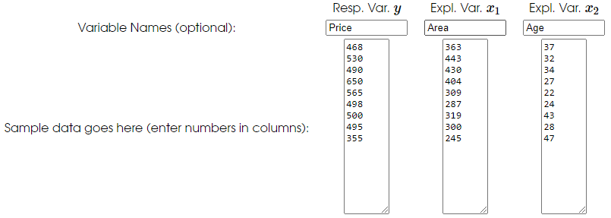
Conclusion
To construct a model involving two or more factors, we can use free online statistical applications, such as
https://stats.blue/Stats_Suite/multiple_linear_regression_calculator.html
https://www.socscistatistics.com/tests/multipleregression/default.aspx

Slide 58
Conclusion
However, it is worth noting that a small amount of data is involved in the above activities.
Besides, there are many other factors that affect how property owners set their marked price.
Therefore, we have to collect more data as well as continue to refine our model by considering more factors.

